Slide 1
Quantum Computing Architectures (EE274) Lecture 22
Hiu-Yung Wong
apr. 17, 2025
hiuyung.wong@sjsu.edu, Office: ENG363
http://www.sjsu.edu/people/hiuyung.wong/index.html

Slide 2
Outline
Circuit Quantization

Slide 3
Announcement

Slide 4
Superconducting Qubit Readout
Chapter 22 of “Quantum Computing Architecture and Hardware for Engineers: Step by Step”

Slide 5


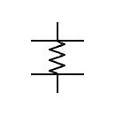
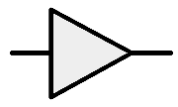
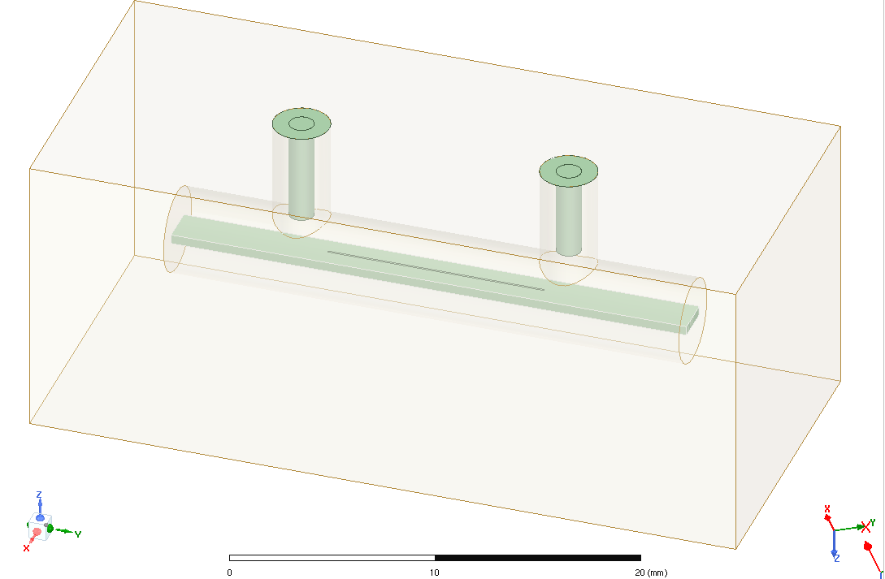
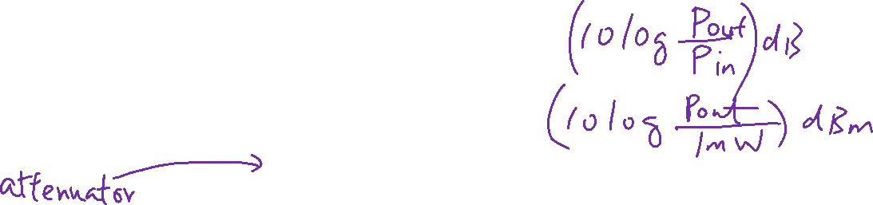
A Superconducting Quantum Computer
From the Previous Lecture
OPX Quantum Machines
Manipulation and reset
Readout
Amplifier
+40dB
Read Pulse: -47dBm at plate
300K
-20dB
HEMT
+40dB
Readout quality depends on
Readout Pulse Width (t_{p})
Readout Pulse Energy (E_{p})
Resonator quality factor
Noise
4K
-20dB
700mK
-20dB
Read Pulse: -123dBm at plate
10mK
363 photons (3500ns)
Resonator & Qubit
TWPA
+20dB
Hiu Yung Wong et al., "A Simulation Methodology for Superconducting Qubit Readout Fidelity," SSE, 2023.

Slide 6
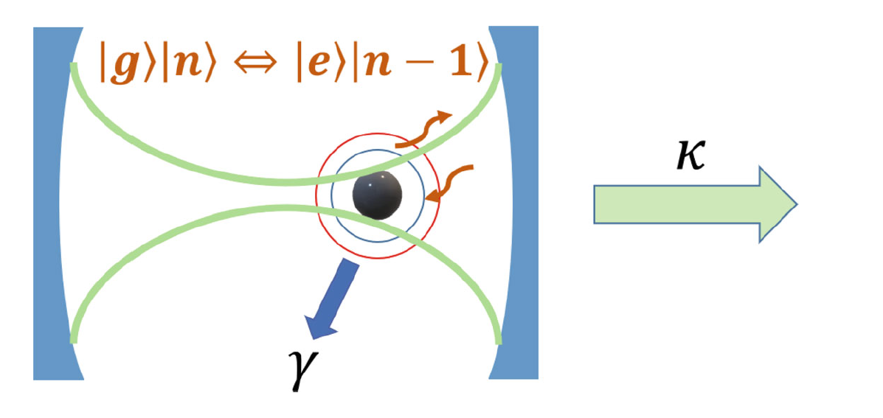

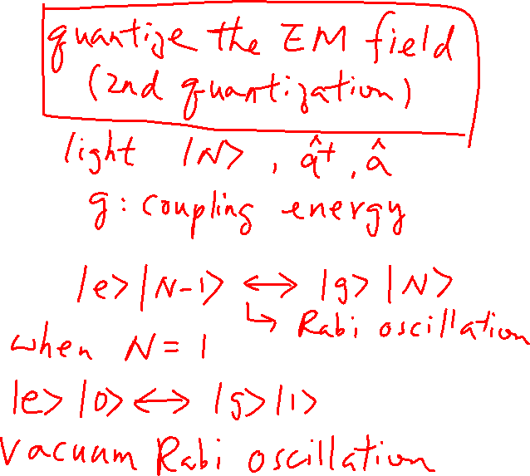
Cavity Quantum Electrodynamics (QED)
From the Previous Lecture

Slide 7
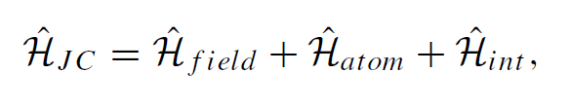
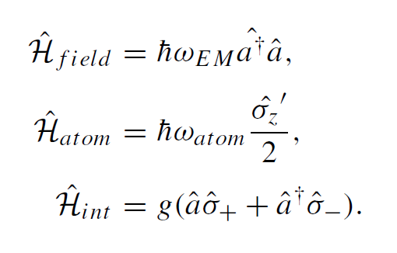

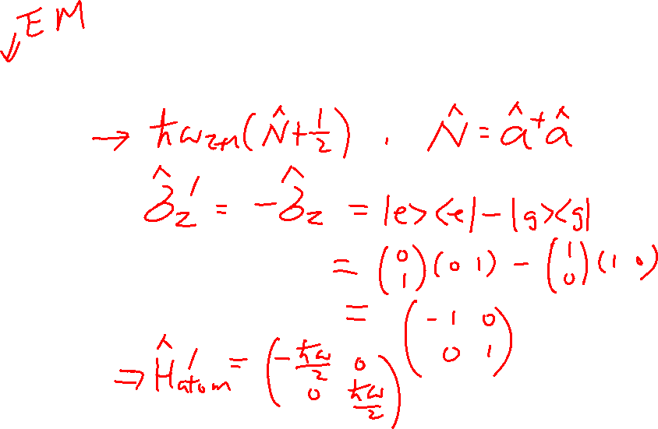
Jaynes-Cummings Hamiltonian Consider only 2 levels
From the Previous Lecture

Slide 8
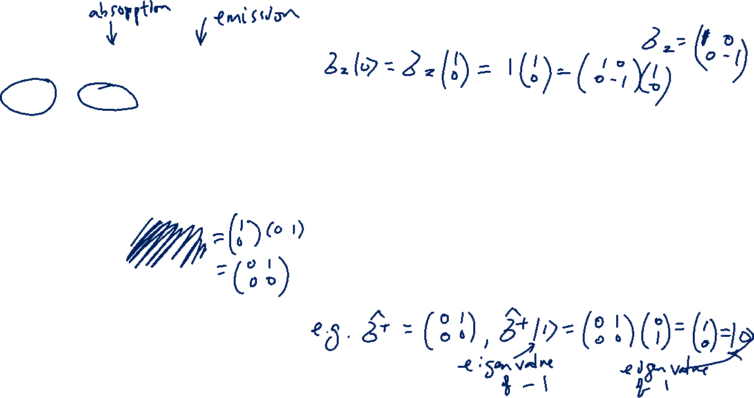
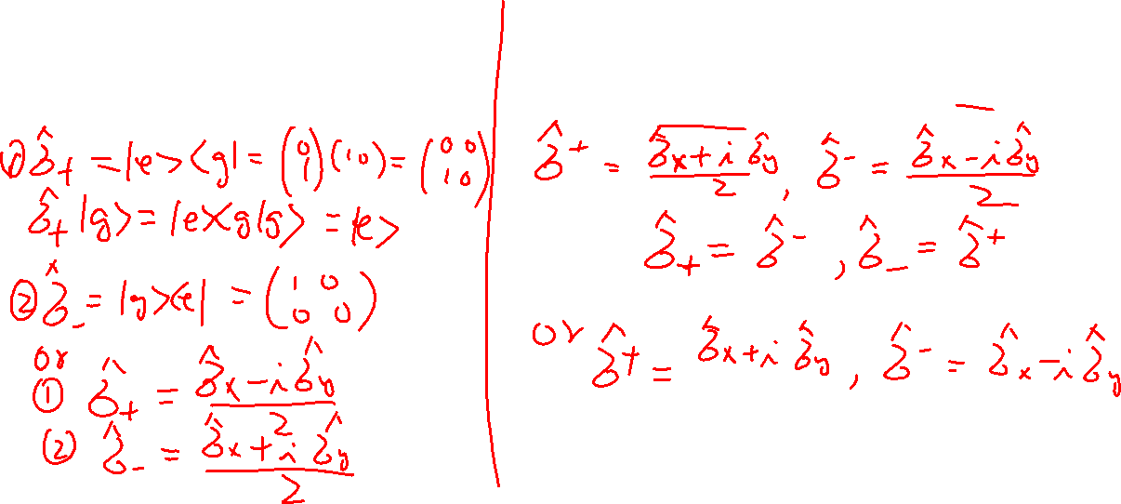
Raising and Lower Operators
From the Previous Lecture
raising and lowering operators of a
two-level system
raising and lowering operators of σ_{z}’s eigenvalues

Slide 9
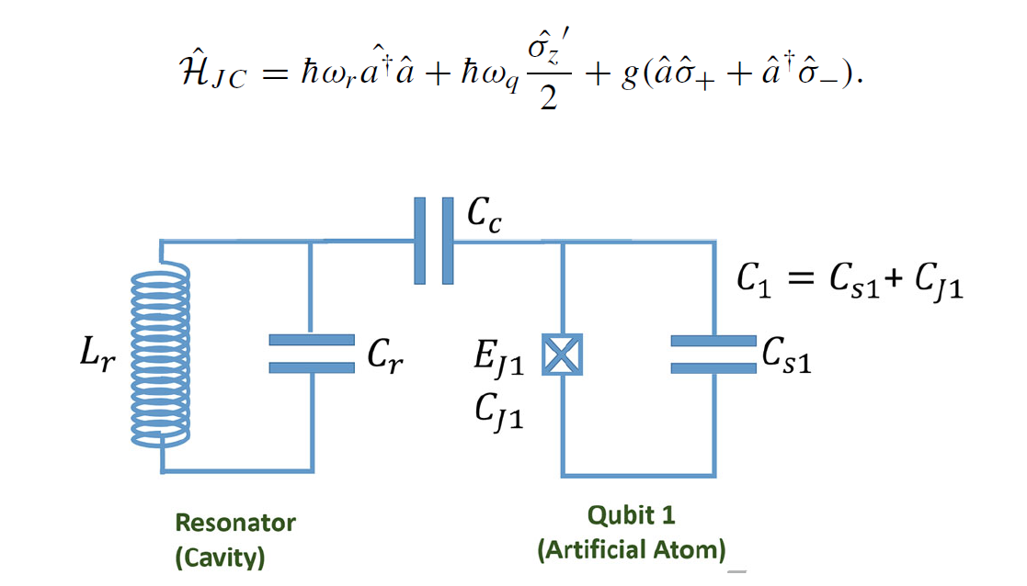
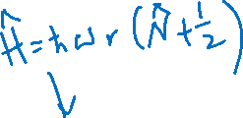
Circuit QED – Two level system
We can control the artificial atom’s properties through layout

Slide 10
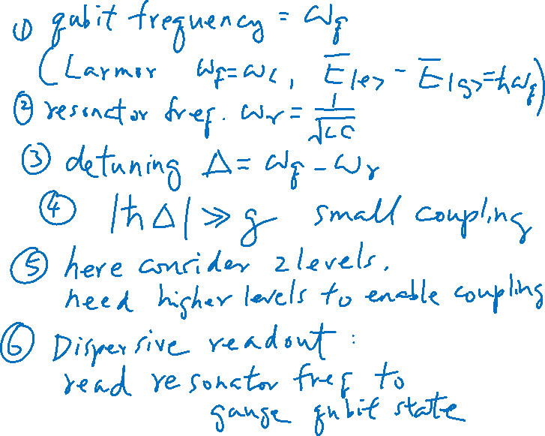
Dispersive Readout

Slide 11
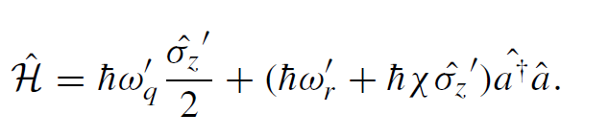
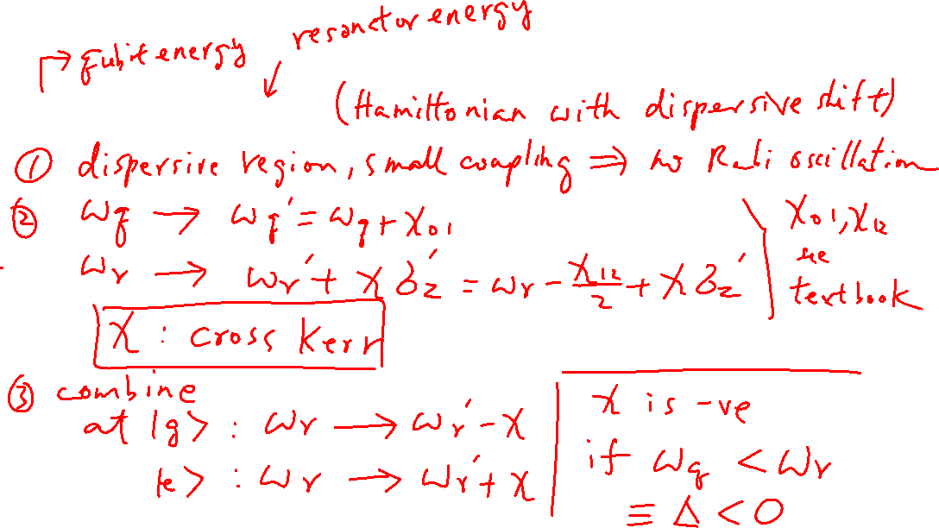
Dispersive Shift

Slide 12
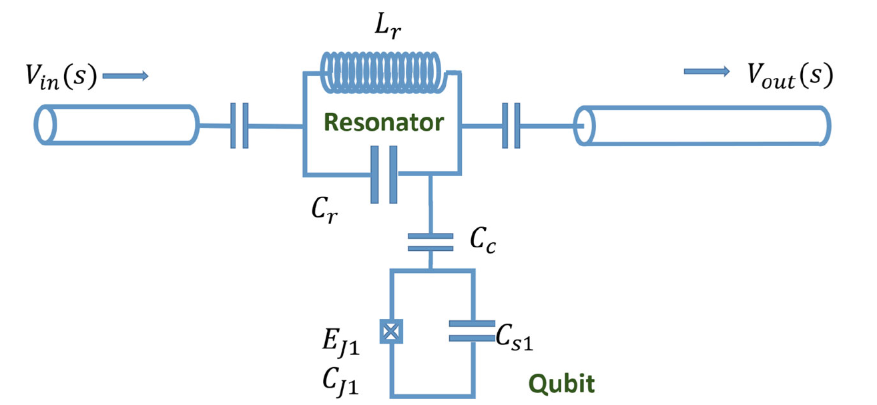
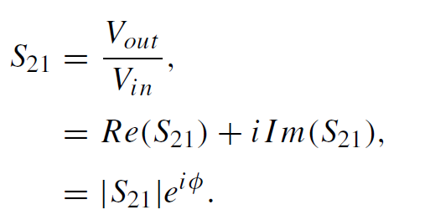
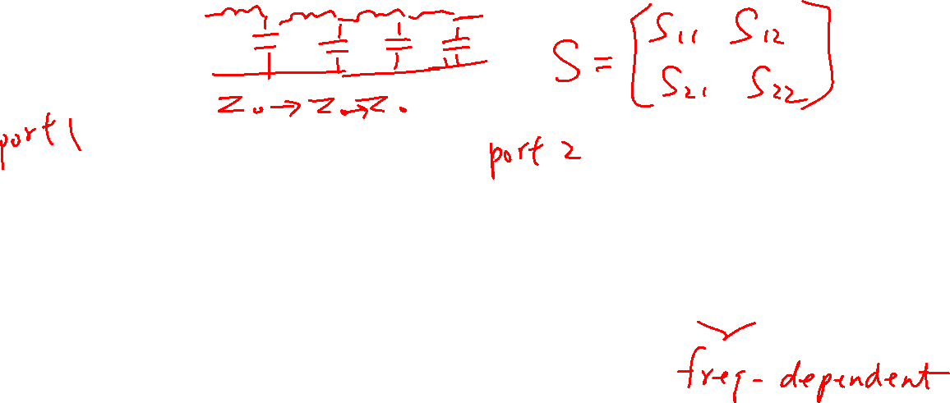
Example

Slide 13
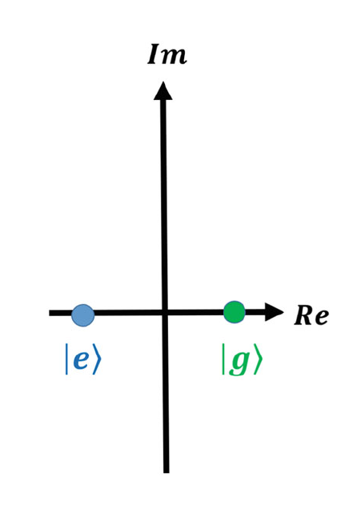
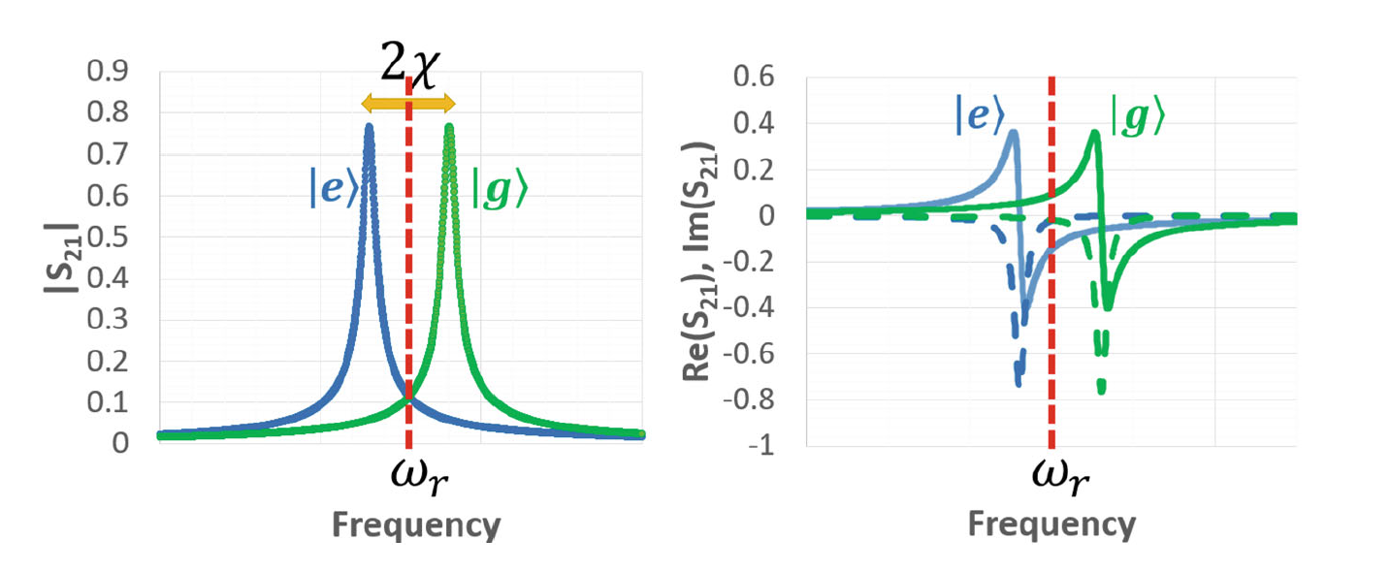
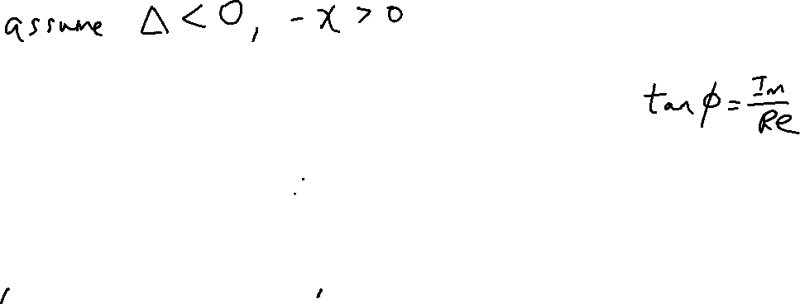
Example

Slide 14
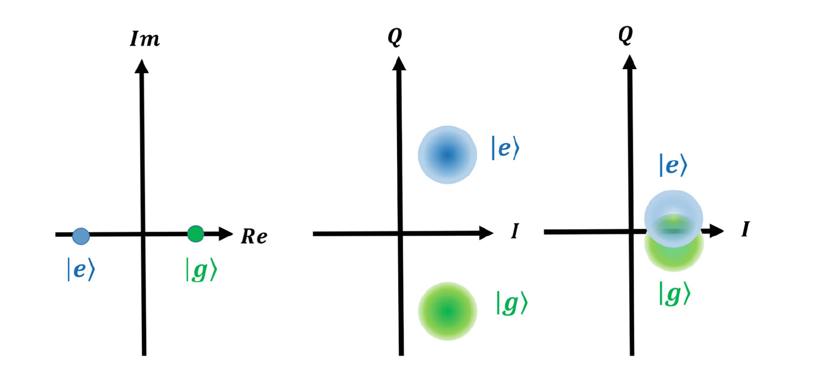
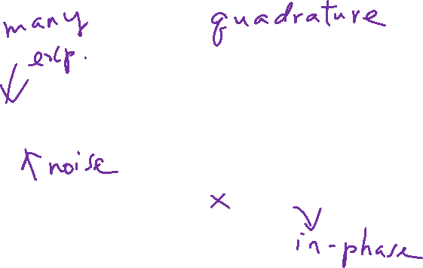
I-Q Blobs

Slide 15
Energy Participation Ratio
Youtube Playlist: Lab 1 to Lab 10 videos
Quantum Computing Hardware and Architecture
https://www.youtube.com/playlist?list=PLnK6MrIqGXsL1KShnocSdwNSiKnBodpie

Slide 16
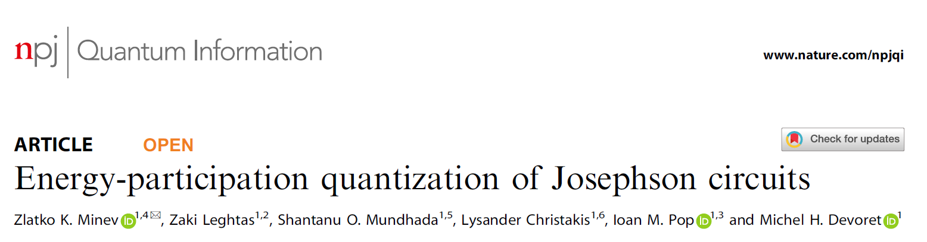

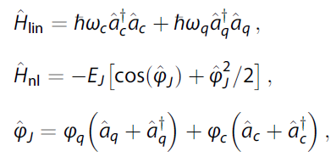
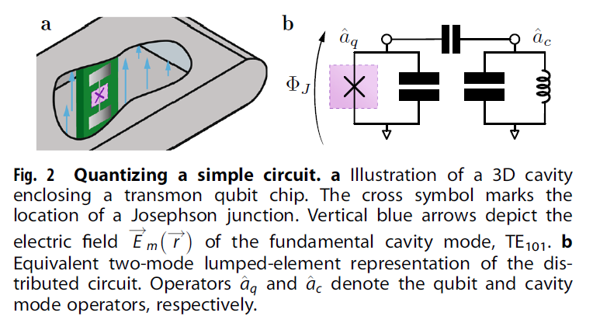
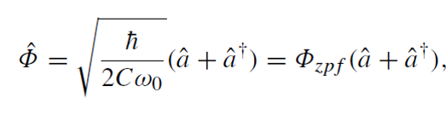
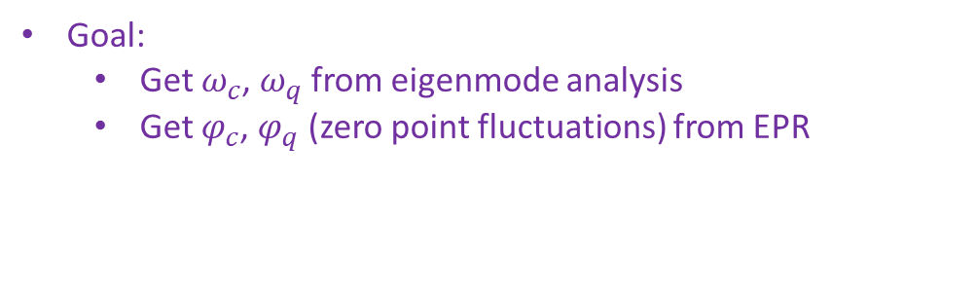
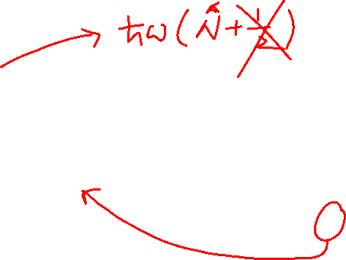
Energy Participation Ratio and Class Project
Reduced the quantization problem to “what fraction of the energy mode m is stored in element j?
Energy participation ratio: p_{mj}
Use eigenmode simulation in HFSS
Recall: zero point fluctuation of flux
Goal:
Get $ω_{c}$, $ω_{q}$ from eigenmode analysis
Get $φ_{c}$, $φ_{q}$ (zero point fluctuations) from EPR

Slide 17


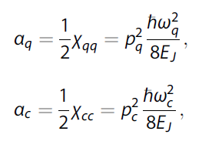


Energy Participation Ratio and Class Project
Can be computed from E and H field at mode m
P_{m} is between 0 and 1
Alpha’s: Anharmonicity (to be taught later)
χqc is the qubit–cavity dispersive shift (cross-Kerr coupling).

Slide 18
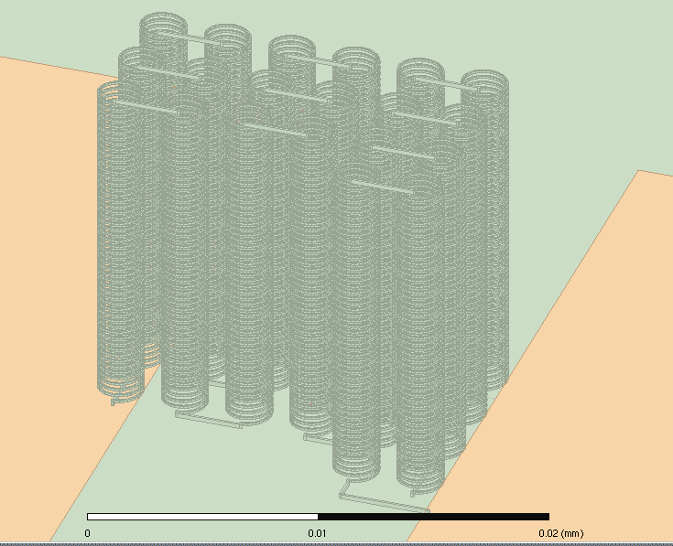
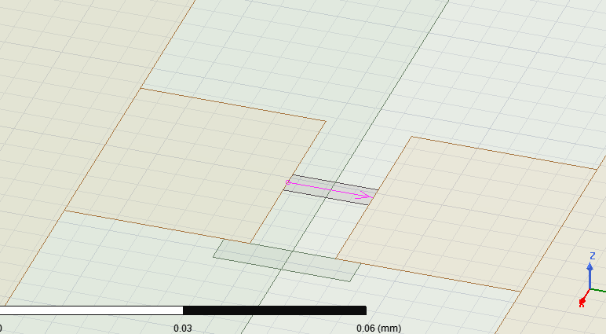
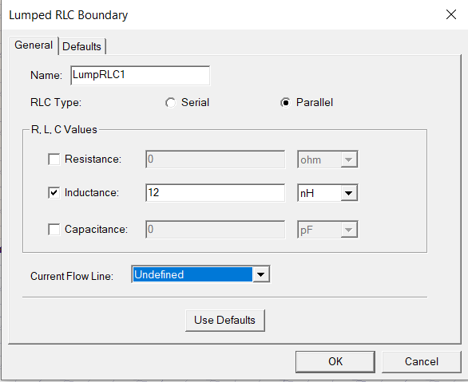
Modeling of Josephson Junction Inductance
JJ Inductance is very large. To model 12.53nH, I need this:
Therefore,

Slide 19
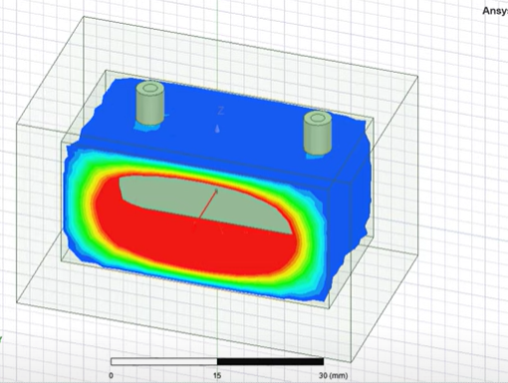
Project
Study mode 1 and mode 2
Accuracy = 1%, maximum 10 passes
Keep L_{J} = 12nH
Change the location of the Sapphire and the JJ (you should have created them with parameters) and study how the following change
Cross-Kerr
Q
Resonant Frequency

Slide 20
Why we care about Cross Kerr?
If a readout pulse is 200ns, its spectrum width is 1/200ns = 5MHz. Then you need a cross-kerr of about 10MHz

Slide 21
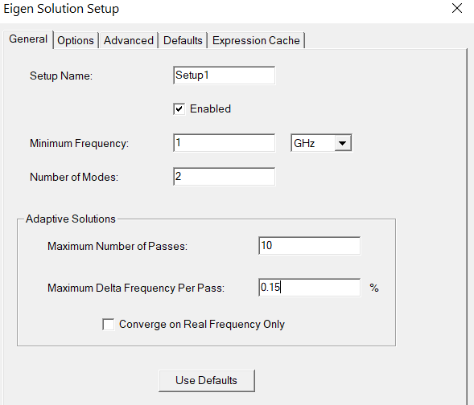
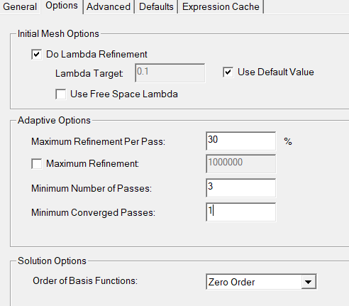
Accuracy (Example)
Reality: If cross-kerr is 10MHz, assume mode at 6GHz, need 0.17%
Set convergence criteria to be 0.15% (But in this project just set 1%)
Using 2 might be more accurate
Need this for early stop as im part is very small but larger variation

Slide 22
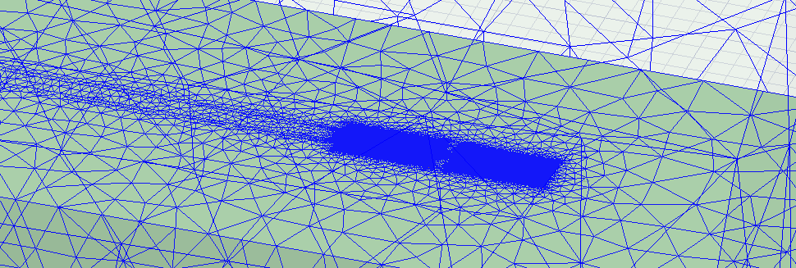
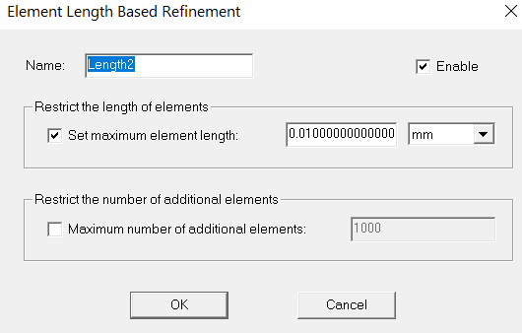
Denser Mesh for JJ

Slide 23
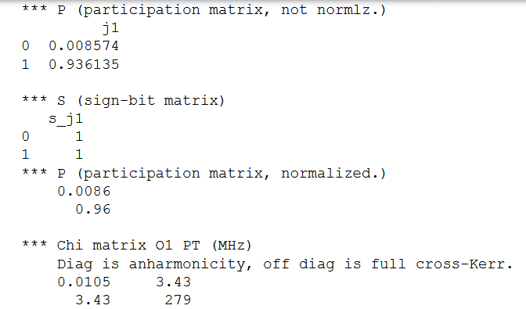
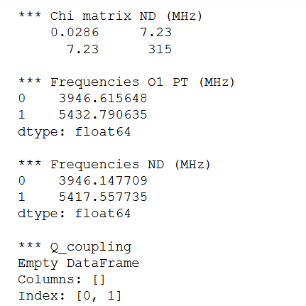
Where to find the information (Example)

